Slide 1
Nanoplasmons: Fundamental and Technologies.
By
Gargee Kotwal
Gulsha Motihar
Ritesh Chogale

Slide 2
Introduction:
The Lycurgus cup and Le Sainte Chapelle bear testament to the fact that the field of nanoplasmonics had been discovered long before we could explain the principles and fundamentals; but we can exploit it to a variety of applications.
Central to the theme of nanoplasmonics is the manipulation of electromagnetic waves in the nanodomain. Interaction of light with particles of the order 2 nm to 200 nm result into penetration of the electrical field in the particle. This penetration is the cause for oscillations of the electrons, displacing them with respect to lattice ions. The displaced charges accumulate along the surface of the particles on opposite sides.
Attractive and restorative forces are set up which result into an electron oscillator; quantum of these oscillations is the surface plasmon.When the frequency ω_{sp} of this SP is close to the frequency of the excitation light wave, a resonance (Surface plasmon resonance; SPR) occurs leading to the enhanced local field at the surface which is another important aspect of nanoplasmonics. These highly enhanced intensities of electric field are known as hotspots.

Slide 3


The Lycurgus cup
Le Sainte Chapelle

Slide 4
Solar cell:
An effort is being made to decrease the capital cost of the solar cell by considering use of thin film solar cell technologies. Although cost friendly, TFSCs lack the efficiency of silicon wafer solar cells. TFSCs are made from various semiconductor materials like Cadmium telluride, copper indium diselenide, amorphous and polycrystalline silicon which are then deposited on cheap substrates like glass or plastic.
The lack of efficiency of these TFSCs is where nanoplasmonics play their part. A film of plasmonic nanoparticles can improve solar cell performance by trapping incident light into the photoabsorbing layer. The optical properties of this film depend on the size, shape and surface coverage of the nanoparticles.
Due to their large cross sections and low parasitic absorption, silver nanoparticles of the order 100 nm diameter have good scattering properties making them an attractive asset to the application.

Slide 5
Solar cell continued…
Various studies by Stuart and Hall, Derkacs et al., Schaadt et al., Pillai et al., Dai et al. have shown significant increase in photocurrent by using nanoplasmon coating on TFSC.
These photocurrent enhancements can be explained by explaining the light scattering by metal nanoparticles. Collective oscillations of the conductive electrons cause plasmon resonance. Light at wavelengths near the plasmon resonance scatter light strongly.
At SPR the scattering cross-section is much much more than the geometrical cross section of the particle. For example, at resonance a small silver nanoparticle in air has a scattering cross-section that is around ten times the cross sectional area of the particle.This particle can fully absorb and scatter incident light. For light trapping it is important that scattering is more efficient than absorption. This can be achieved in nanoparticles of size around 100 nm.

Slide 6
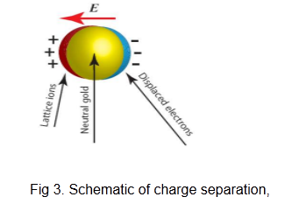

Slide 7
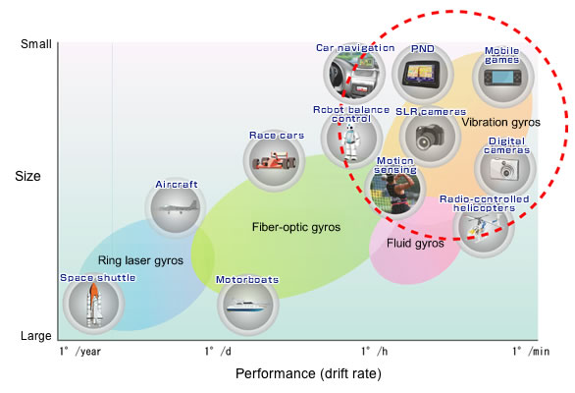
Sensors:
Our venture in the nano world has brought into light better fabrication techniques for the development of small, novel sensors that enable miniaturization and integration. Biochemical sensing provides a good field for development of nanostructured sensors. Diverse properties of nanomaterials can be utilized for analysis of biomolecular interactions.

Slide 8
Biosensors
A biosensor is a device which consists of a biological component which interacts with an analyte to produce a biological response. This response is detected and converted into electrical signal by a transducer. The performance of a surface biosensor is dependent on rate of analyte delivery which is a limiting factor. This limitation can be overcome by using a hybrid biosensing platform by merging nanoplasmonics and nanofluidics. This hybrid biosensing platform enables targeted delivery of analytes to the sensory surface.
The evanescent field created due to the surface plasmons is extremely sensitive to refractive index (RI) changes close to the metal surface. This sensitivity toward RI acts as detection probe in nanoplasmonic biosensors
Nanoplasmonic biosensors can be designed exploiting one of the two fundamental properties:
SPR
LSPR

Slide 9
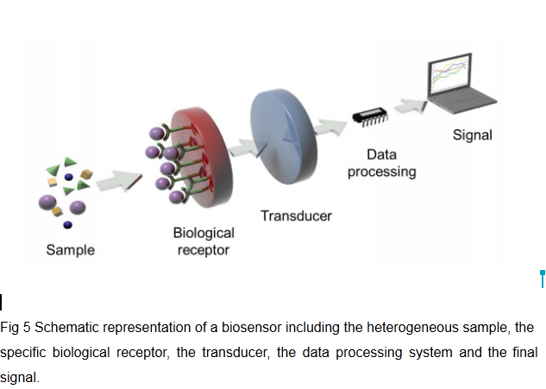

Slide 10
SPR based Biosensors:
Eversince there introduction in1983 SPR based sensing devices have become one of the most widely used label free sensory devices. SPR sensing has excellent properties which makes it optimum for its application in different fields, such as environmental monitoring, food quality and safety analysis, diagnostics and biomedicine, biological engineering, drug discovery, etc.
Biochemical interactions in the vicinity of the SPR induce changes in the RI altering the propagation conditions of the SP. These changes are tracked and quantified to give a measurable signal without the need of labeling.
Nanoplasmons can be employed to optical biosensors using the principle SPR in thin gold films. Home pregnancy test is very common example of use of nanoparticle plasmon for the detection of human chorionic gonadotropin (HcG) which attaches to gold nanoparticles. Red light is reflect if HcG is present otherwise blue

Slide 11
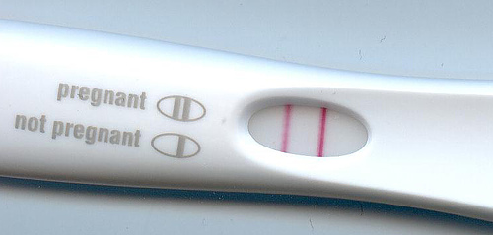
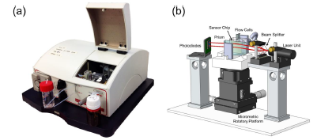

Slide 12
LSPR:
LSPR refractometric biosensors are the next generation plasmonic sensing platforms as they offer highly sensitive analytical tools with multiple capabilities and show great potential for integration and miniaturization.83
As we know that the shape and size of plasmonic nanostructures can affect their properties and behaviour, LSPR can be tailored and tuned to function along the entire VIS and NIR regions of the electromagnetic spectrum. Along with the change in RI, evanescent field leads to displacements of the LSPR peak.

Slide 13
Conclusion
Nanoplasmonic devices have wide applications in various fields like electronics, bio sensing, spectroscopy etc. It is a technology of the future and the applications would become more and more mainstream. Once, the technique was used in artistic endeavours, today we have huge scientific development in it.

Slide 14
References
[1] H. R. Stuart and D. G. Hall, "Island size effects in nanoparticle-enhanced photodetectors " Appl. Phys. Lett. 73, 3815 (1998).
[2] D. M. Schaadt, B. Feng, and E. T. Yu, "Enhanced semiconductor optical absorption excitation in metal nanoparticles," Appl. Phys. Lett. 86, 063106 (2005).
[3] D. Derkacs, S. H. Lim, P. Matheu, W. Mar, and E. T. Yu, "Improved performance of amorphous silicon solar cells via scattering from surface plasmon polaritons in nearby metallic nanoparticles," Appl. Phys. Lett. 89, 093103 (2006).
[4] S. Pillai, K. R. Catchpole, T. Trupke, and M. A. Green, "Surface plasmon enhanced silicon solar cells," J. Appl. Phys. 101, 093105 (2007).
[5] Dai, Han, Ruiqiang Ding, Meicheng Li, Yingfeng Li, Ganghai Yang, Dandan Song, Yue Yu, and Mwenya Trevor. "Abnormal thermal effects on the surface plasmon resonance of Ag nanoparticles on the surface of silicon." Thin Solid Films 584 (2015): 378-381.
[6] Hill, R.T. Plasmonic biosensors. Wiley Interdisciplinary Reviews: Nanomedicine and Nanobiotechnology (2014).
[7] Long, Y.-T. & Jing, C. in Localized Surface Plasmon Resonance Based Nanobiosensors 23-37 (Springer, 2014).

Slide 15
[8] Soler Aznar, Maria, Laura M. Lechuga, M. Carmen Estévez, and Carles Arús. "Nanoplasmonic biosensors for clinical diagnosis at the point of care." (2015).
[9] Liedberg, B., C. Nylander, and I. Lundstrom Surface-Plasmon Resonance for Gas-Detection and Biosensing. Sensors and Actuators B 4, 299-304 (1983).
[10] Homola, J. Surface Plasmon Resonance Sensors for Detection of Chemical and Biological Species. Chemical Reviews 108, 462-493 (2008).
[11] Sepúlveda, Borja, Paula C. Angelomé, Laura M. Lechuga, and Luis M. Liz-Marzán. "LSPR-based nanobiosensors." Nano Today 4, no. 3 (2009): 244-251

Slide 16
THANK YOU!!!

